Slide 1
The Rebound Pendulum: Energy Dissipation in Classical Systems
Cole Prather, M.S.
April 24th, 2025

Slide 2
Abstract
First explored in the context of timekeeping and planetary motion, the pendulum has long served as a foundational model in classical mechanics. This talk revisits the system in a modified form—the rebound pendulum—as a means of investigating energy dissipation through impact. Though simple in form, the rebound pendulum offers a precise and versatile framework for analyzing non-conservative energy exchange. By connecting potential, kinetic, and geometric measures of motion through the coefficient of restitution, a unified description of collision efficiency emerges. The square of this coefficient provides a direct measure of energy retained post-impact, whether quantified by rebound height, angular deflection, or velocity. Experimental methods are considered for validating these relationships across a range of materials, revealing the restitution coefficient not merely as a descriptive parameter, but as a diagnostic tool for probing material response and impact dynamics. In reframing the pendulum from a standard classroom device to a model of dissipative behavior, the discussion underscores both the enduring relevance of classical systems and their capacity to yield insight into the subtleties of physical interaction.

Slide 3
Outline
Problem Statement
Motivating the Problem
Assumptions
Working the Problem
Restitution Coefficient
Identifying Relationships
Energy Losses and Practical Measurements
Other Analogies
Conclusion

Slide 4
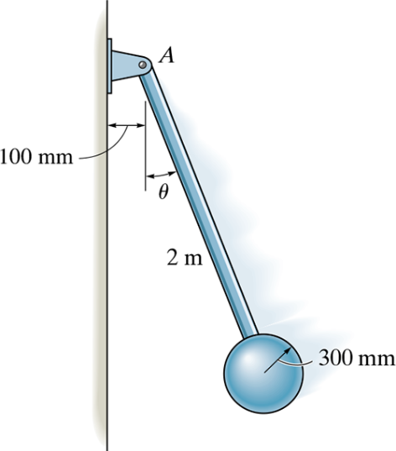

Problem Statement
Consider a modified pendulum as shown.
The pendulum consists of a $15$-$kg$ solid ball and $6$-$kg$ rod. If it is released from rest when $θ_{1}=90°$, determine the angle $θ_{2}$ after the ball strikes the wall, rebounds, and the pendulum swings up to the point of momentary rest. Take $e=0.6$.

Slide 5
Motivating the Problem
How do we measure or calculate energy loss from a single collision?
How can rebound angle, rebound height, or rebound velocity reveal this loss?
How does rebound angle relate to the restitution coefficient, energy, or efficiency?
Why is this interesting or useful?

Slide 6
Motivating the Problem (w/ History)
1602 – Galileo Galilei discovers the isochronism of the pendulum
Period is independent of amplitude (for small angles)
Proposes pendulums for time-keeping
Start of classical interest in pendular motion
1656 – Christiaan Huygens builds the first pendulum clock
Develops precision instruments around pendular motion
Established mathematical treatment of oscillatory motion
1742 – Benjamin Robins invents the ballistic pendulum
Measured projectile velocity via inelastic collisions
One of the first applications of momentum and energy in pendular motion
1901 – Georges Charpy develops the Charpy impact test
Measured absorbed energy in fractures
Still widely used today

Slide 7

Assumptions
Pendulum is released from an angle of $90°$.
Pendulum collides perfectly perpendicular to rebound surface (head-on collision).
The rebound surface is fixed and remains stationary.
The pendulum’s moment of inertia remains constant throughout collision (no deformations).
Energy is conserved leading up to and immediately following the collision (ignoring axle friction and drag forces).
Energy is lost during the collision (inelastic collision).

Slide 8


Working the Problem
Beginning with conservation of energy before and after the collision,
Assuming the moment of inertia remains constant throughout the collision,
$$I=\frac{2mgh_{1i}}{ω_{1f}^{2}}=\frac{2mgh_{2f}}{ω_{2i}^{2}}$$
$$\frac{h_{2f}}{h_{1i}}=\frac{ω_{2i}^{2}}{ω_{1f}^{2}}=\frac{v_{2i}^{2}}{v_{1f}^{2}}$$
Great, but what is the rebound height, $h_{2f}$, and the rebound speed (translation and rotational)?! How do they relate to the rebound angle or the restitution coefficient?
$$KE_{1i}+PE_{1i}=KE_{1f}+PE_{1f}$$ | $$KE_{2i}+PE_{2i}=KE_{2f}+PE_{2f}$$
$PE_{1i}=KE_{1f}$ | $$KE_{2i}=PE_{2f}$$
$$mgh_{1i}=\frac{1}{2}Iω_{1f}^{2}$$ | $$\frac{1}{2}Iω_{2i}^{2}=mgh_{2f}$$
$$I=\frac{2mgh_{1i}}{ω_{1f}^{2}}$$ | $$I=\frac{2mgh_{2f}}{ω_{2i}^{2}}$$

Slide 9
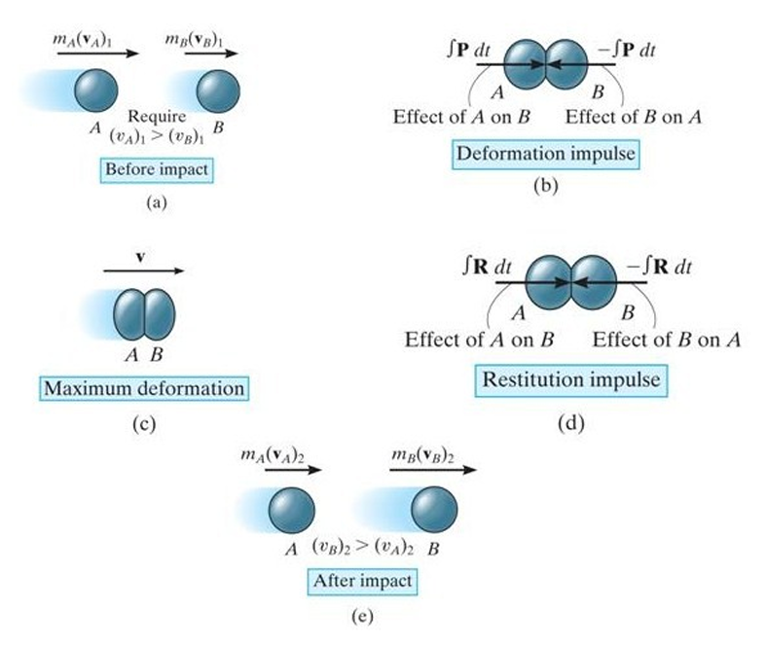

Restitution Coefficient
Assuming no mass is transferred during the collision, the restitution coefficient is given by:
$$e=\frac{\int{R dt}}{\int{P dt}}=\frac{v_{B2}−v_{A2}}{v_{A1}−v_{B1}}$$
Elastic Impact $e=1$
Inelastic Impact $0<e<1$
Plastic Impact $e=0$
We will see later how this directly relates to energy and efficiency!

Slide 10

Working the Problem (continued)
Assuming the rebound surface is fixed and does not move,
$$v_{B1}=v_{B2}=0$$
The rebound coefficient becomes,
$$e=\frac{v_{B2}−v_{A2}}{v_{A1}−v_{B1}}=\frac{−v_{A2}}{v_{A1}}$$
Since the pendulum swings to the left before impact, $v_{A1}$ is negative, and the coefficient is positive.
Recalling the relationship, recognizing the ratio of velocity after/before, and squaring the coefficient,
$$\frac{h_{2f}}{h_{1i}}=\frac{ω_{2i}^{2}}{ω_{1f}^{2}}=\frac{v_{2i}^{2}}{v_{1f}^{2}}=e^{2}$$
Yeah, okay but what about the angle?

Slide 11


Working the Problem (continued)
By property of cosine, the rebound angle can relate to the release height and rebound height,
$$cosθ_{2}=\frac{h_{1i}−h_{2f}}{h_{1i}}=1−\frac{h_{2f}}{h_{1i}}$$
Or, rearranging for a ratio of the rebound height to initial height,
$$\frac{h_{2f}}{h_{1i}}=1−cosθ_{2}$$
Now, relating back...
$$1−cosθ_{2}=\frac{h_{2f}}{h_{1i}}=\frac{ω_{2i}^{2}}{ω_{1f}^{2}}=\frac{v_{2i}^{2}}{v_{1f}^{2}}=e^{2}$$ To solve the problem statement,
$$θ_{2}=\arccos\left(1−e^{2}\right)$$

Slide 12

Identifying Relationships
Consider how gravitational potential energy is proportional to displacement and how kinetic energy is proportional to velocity squared:
$PE_{gravity}=mgh$ $KE=\frac{1}{2}mv^{2}=\frac{1}{2}Iω^{2}$
The ratio of potential energy after rebound to before is,
$$\frac{mgh_{2f}}{mgh_{1i}}=\frac{h_{2f}}{h_{1i}}$$
And the ratio of kinetic energy after rebound to before is,
$$\frac{\frac{1}{2}Iω_{2i}^{2}}{\frac{1}{2}Iω_{1f}^{2}}=\frac{ω_{2i}^{2}}{ω_{1f}^{2}}$$
Then if the ratio of energy out to energy in is the efficiency, $ε$, then,
$$ε=\frac{h_{2f}}{h_{1i}}=\frac{ω_{2i}^{2}}{ω_{1f}^{2}}$$
So now,
$$1−cosθ_{2}=\frac{h_{2f}}{h_{1i}}=\frac{ω_{2i}^{2}}{ω_{1f}^{2}}=\frac{v_{2i}^{2}}{v_{1f}^{2}}=e^{2}=ε$$

Slide 13

Identifying Relationships
Let’s reexplore this relationship one last time,
$$1−cosθ_{2}=\frac{h_{2f}}{h_{1i}}=\frac{ω_{2i}^{2}}{ω_{1f}^{2}}=\frac{v_{2i}^{2}}{v_{1f}^{2}}=e^{2}=ε$$
If,
$$cosθ_{2}=1−e^{2}=1−ε$$
And since $ε$ is the efficiency, then $1−ε$ must be the inefficiency! Let’s call it $ξ$.
Then, in complete summary:
$$1−cosθ_{2}=\frac{h_{2f}}{h_{1i}}=\frac{ω_{2i}^{2}}{ω_{1f}^{2}}=\frac{v_{2i}^{2}}{v_{1f}^{2}}=e^{2}=ε=1−ξ$$
And,
$$cosθ_{2}=ξ=1−e^{2}$$

Slide 14

Energy Loss in a Rebound Pendulum
Having shown how the restitution coefficient relates to energy and efficiency, consider the three forms of collisions:
Elastic (Energy Conserved) $h_{f}=h_{i} ; θ_{f}=θ_{i}$
Inelastic (Energy Loss)
$$h_{f}<h_{i} ; θ_{f}<θ_{i}$$
Plastic (Energy Absorbed)
$$h_{f}=0 ; θ_{f}=0$$
For extreme cases, $e=ε$, though in general,
$$e^{2}=ε$$

Slide 15

Practical Measures of Energy Loss
Inelastic Collision (Energy Loss)
$$KE_{i}+PE_{i}+W_{nc}=KE_{f}+PE_{f}$$
Energy leaves system and is not accounted for (heat, friction, drag, sound, deformations)
In kinematics, energy losses are often ignored (and offer a reasonable approximation).
Hard to measure energy losses in collisions?

Slide 16

Practical Measures of Energy Loss
Gravity is a conservative force, so the path does not affect the work done. Differences in height and potential are not due to a loss of gravity or mass, so the energy is lost elsewhere.
However, air resistance from drag forces and rotational resistance from axel friction depend on path and are non-conservative.
For “large” objects: $W_{drag}=Fdcosθ=\frac{1}{2}CρAv^{2}dcosθ$
For “small” objects (Stokes’ Law): $W_{drag}=6πrηvdcosθ$
$W_{friction}=fdcosθ=μ_{k}mgdcosθ$
Other forms of energy are also released (heat, sound, sometimes light).
$$W_{heat}=mcΔT$$
$$W_{sound}=\left(\frac{p^{2}}{ρc_{sound}}\right)\left(2πr^{2}\right)Δt$$
$$W_{light}=negligible$$
$$W_{nc}=W_{drag}+W_{friction}+W_{heat}+W_{sound}+W_{light}$$
Of course, the non-conservative work is simply the energy lost by the system. But how could it be measured?

Slide 17
Practical Measurements of Energy Loss
Measure initial and rebound angles to evaluate net energy loss
Measure the initial and rebound heights to evaluate net energy loss
Compare total energy loss with energy exchanged (energy audit)
Energy Loss to Drag
Measure the inbound and outbound velocities (translational and rotational) to evaluate kinetic energy loss
Energy Loss to Sound
Measure sound intensity to estimate acoustic energy loss
Energy Loss to Heat
Measure heat signature to estimate thermal energy loss
Use measured speeds to estimate drag forces and energy loss (compare with ideal speeds)

Slide 18
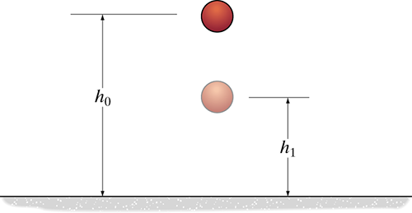

Other Analogies (the trivial)
Consider dropping a ball from rest at some height. As it collides with the ground and rebounds to some height, the velocity with which is impacts the ground is
$$v_{i}=\sqrt{2gh_{i}}$$
And the height to which it rebounds depends on the rebound velocity
$$v_{f}=\sqrt{2gh_{f}}$$
Which both the ratio of velocities and ratio of heights are related to the restitution coefficient as:
$$e=\frac{v_{f}}{v_{i}}=\sqrt{\frac{h_{f}}{h_{i}}}$$

Slide 19
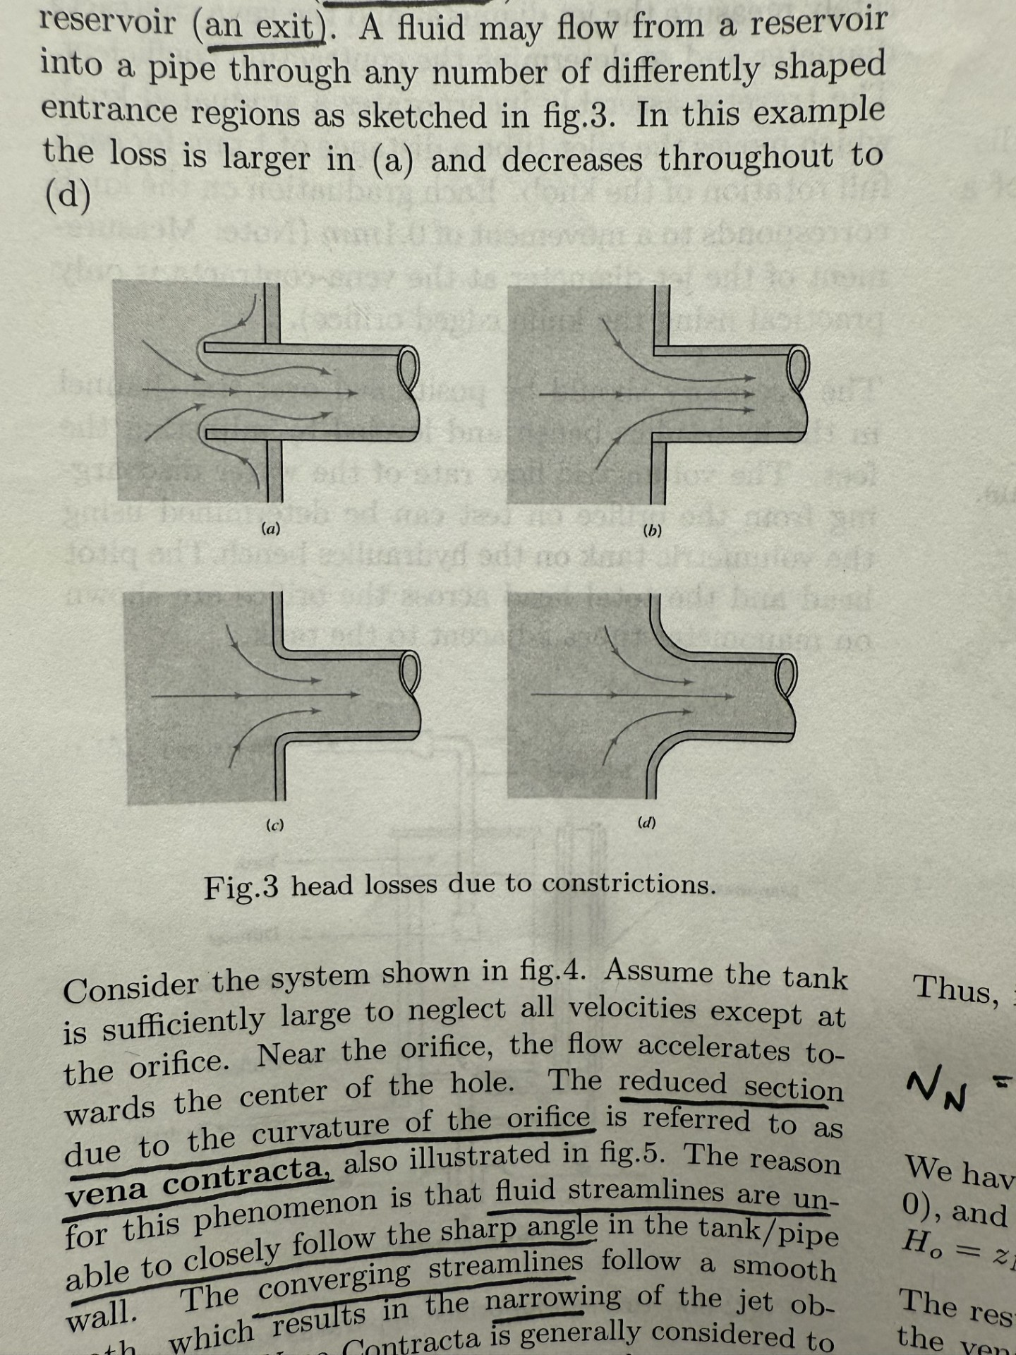
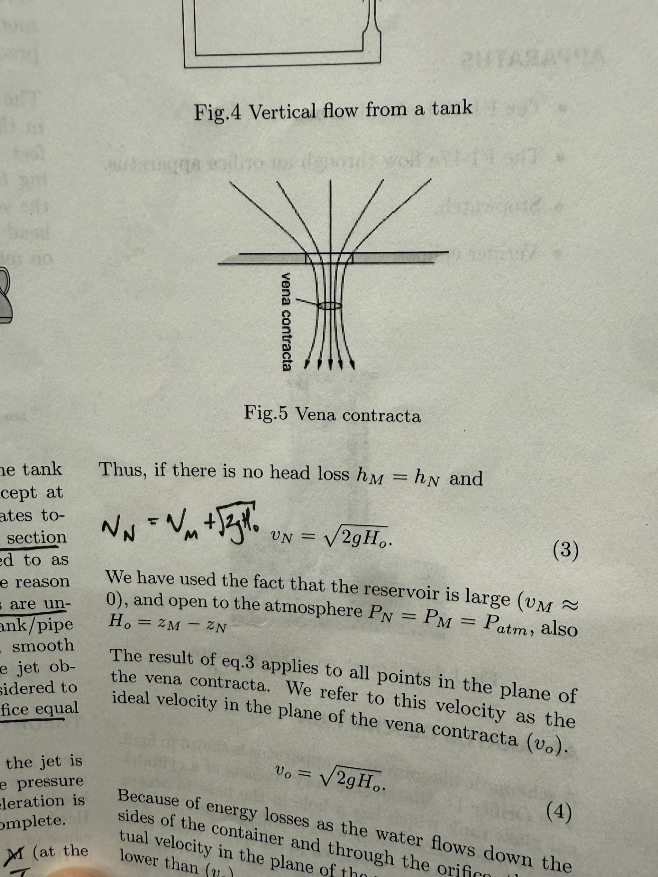
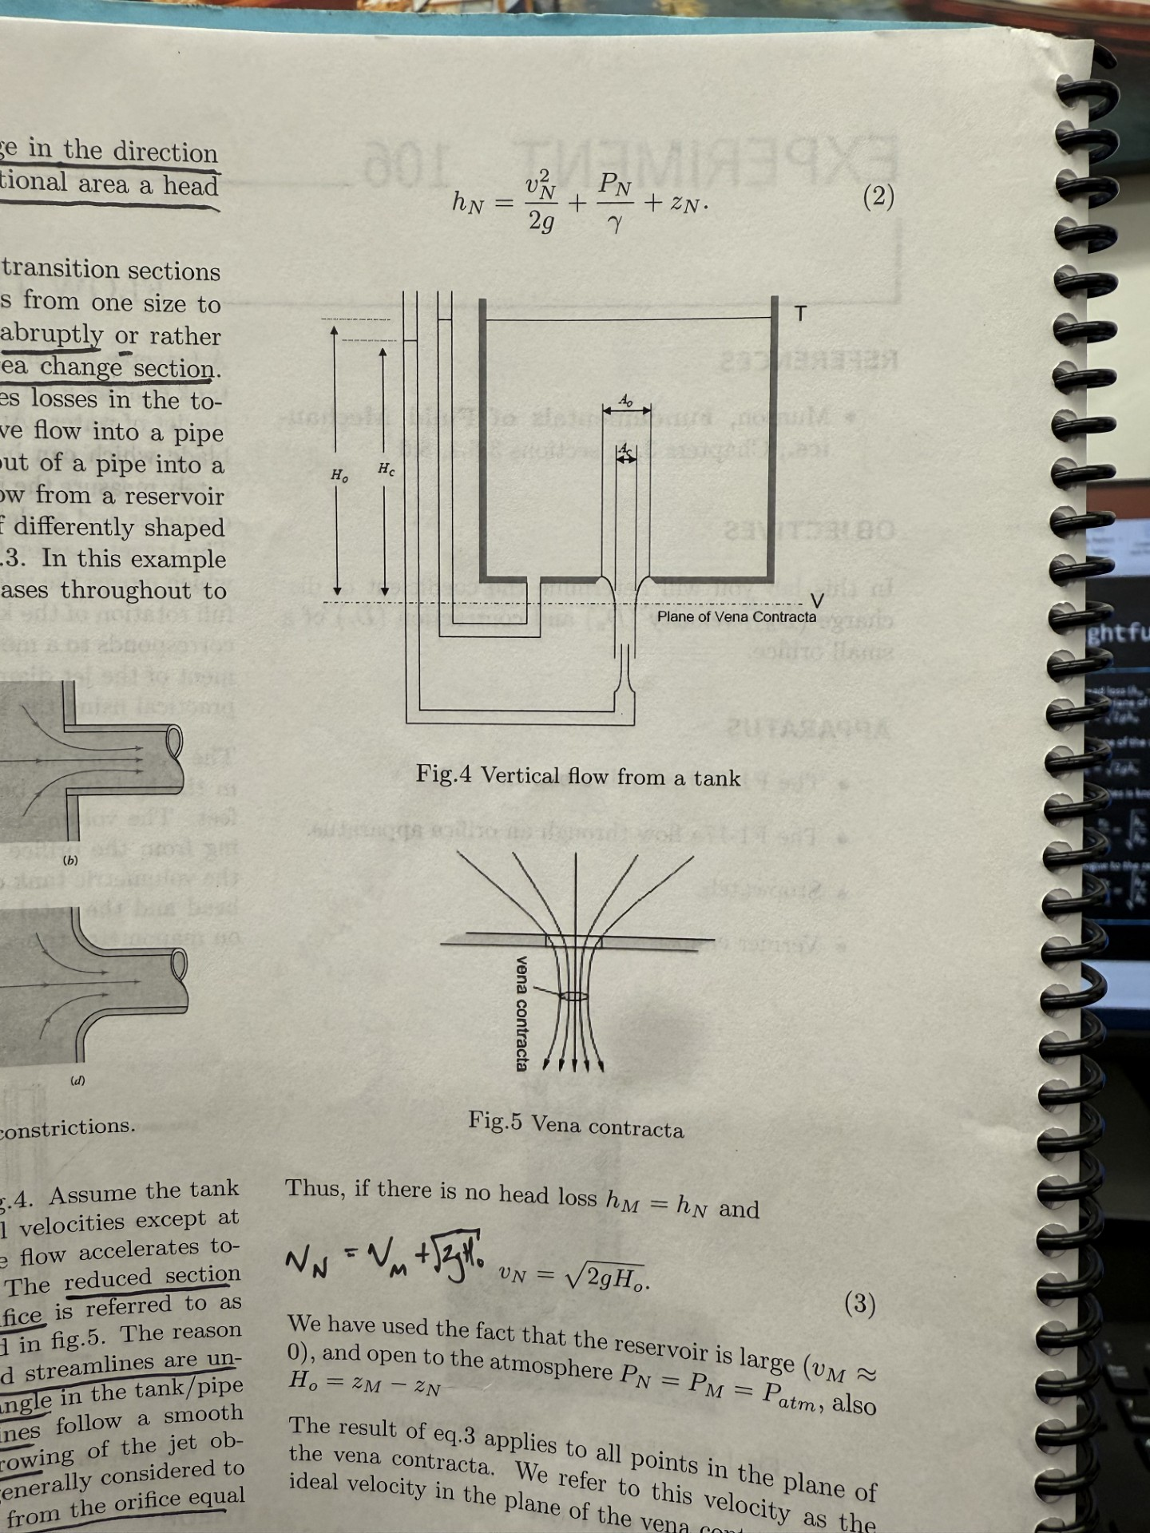

Other Analogies (the insightful)
Consider the relationship of head loss ($h_{o}−h_{c})$ in vertical flow out of a tank. The ideal velocity in the plane of the vena contracta is $$v_{o}=\sqrt{2gh_{o}}$$
And the actual velocity in the plane of the vena contracta is $$v_{c}=\sqrt{2gh_{c}}$$
Such that the ratio of these velocities is known as the coefficient of velocity! $$C=\frac{v_{c}}{v_{o}}=\sqrt{\frac{h_{c}}{h_{o}}}$$
This coefficient is a fluid analogue to the restitution coefficient! $$e=\frac{v_{f}}{v_{i}}=\sqrt{\frac{h_{f}}{h_{i}}}$$

Slide 20

Other Analogies (the invalid)
Consider pushing a block along a surface.
If the force is applied purely horizontally, then the whole of the force contributes to motion along the surface – doing work!
If the force is applied at an angle, then only its horizontal component contributes to moving the block.
If the force is applied vertically, then the block will never move, and no work is done.
$$θ$$

Slide 21

Other Analogies (the invalid)
If the force is applied at $45°$ then half of the force should be productive and the other half should be useless.
Then, blindly applying the analogy...
$$ε=1−\cos{θ}$$
But,
$ε=1−\cos{45°}=0.293$
So, what gives?... Well, if $θ=0$, $cos0=1$, and $ε=0$! The opposite should be true!
Instead, if we let,
$$ε=\cos^{2}{θ}$$
We get a consistent solution! This is interesting to me!
$$θ$$

Slide 22

Conclusion
Demonstrated:
Relationship between the restitution coefficient, efficiency, rebound angle, and the ratios of height and velocity squared.
$$e^{2}=ε=1−ξ=1−cosθ_{2}=\frac{h_{2f}}{h_{1i}}=\frac{ω_{2i}^{2}}{ω_{1f}^{2}}=\frac{v_{2i}^{2}}{v_{1f}^{2}}$$
Three (four?) simple ways to measure efficiency/inefficiency and restitution coefficient.
Three not-so-simple ways to measure energy loss to compare with inefficiency.
The bridge between theory and measurement!

Slide 23

Conclusion
Material | Restitution Coefficient
Steel | 0.9
Rubber | 0.8
Wood | 0.5
Clay | 0.0
Future Work / Ideas:
Use materials with known coefficients to predict/measure/compare results.
Test length as a factor. Galileo showed that the oscillation frequency of a pendulum depends does not depend on mass though it does depend on length. $f=\sqrt{\frac{g}{l}}$
Does the shape of the pendulum matter? Or does it?
How many times does it rebound before falling below a specific angle?
Is it possible to determine and validate which form of energy loss is dominant?

